Slide 1
CS 602 Advanced Java Final Project -Case Study: A Credit-Inquiry Program
Group E
12/19/2016

Slide 2
Introduction of this project
Credit inquiry program which allows manager to obtain lists of customers with zero balances, credit balances and debit balances.
Uses Scanner class to retrieve data from file
Balance data is store in clients.txt
Another option is to retrieve the data from database
Balance data is also stored in a database table

Slide 3
File MenuOption.java

Slide 4
Firstly, import some packets like java.io.IOException, java.lang.IllegalStateException, java.nio.file.Paths, java.util.NoSuchElementException and java.util.Scanner for later use.
The class CreditInquiry start with creating a private final static MenuOption array choices and store the four types of MenuOption in the array.

Slide 5
Main class

Slide 6
In main method it first calls method getRequest to display the menu options, translates the number typed by the user into a MenuOption and stores the result in MenuOption variable accountType. While block loops until the user specifies that the program should terminate, and according the accountType ZERO_BALANCE, CREDIT_BALANCE and DEBIT_BALANCE, switch statement displays a header for the current set of records to be output to the screen using statement “System.out.printf()”. Also, using break statement between each two cases. Finally, the block calls method readRecords using accountType as the variable, which loops through the file and reads every record. And then, assign the return value of the method getRequest to variable accountType.

Slide 7
File CreditInquiry.java-Method Menuoption

Slide 8
File CreditInquiry.java-Method Menuoption

Slide 9
File CreditInquiry.java-Method readRecords

Slide 10
File CreditInquiry.java-Method readRecords

Slide 11
File CreditInquiry.java-Method shouldDisplay

Slide 12
File clients.txt
100 Bob Blue 24.98
200 Steve Green -345.67
300 Pam White 0.00
400 Sam Red -42.16
500 Sue Yellow 224.62
class Scanner and class Formatter
simple sequential-access file
in the directory where the project file are all there

Slide 13
Execution of this project – File System

Slide 14
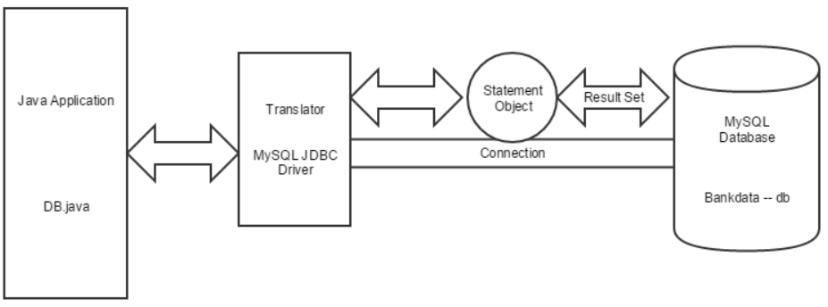
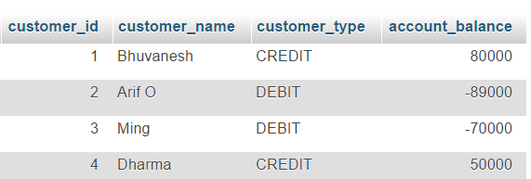
Database
Data is stored as columns and rows in DB.
We use SQL to retrieve data from DB
MySQL Specific driver is used in Java to connect the application to DB.

Slide 15
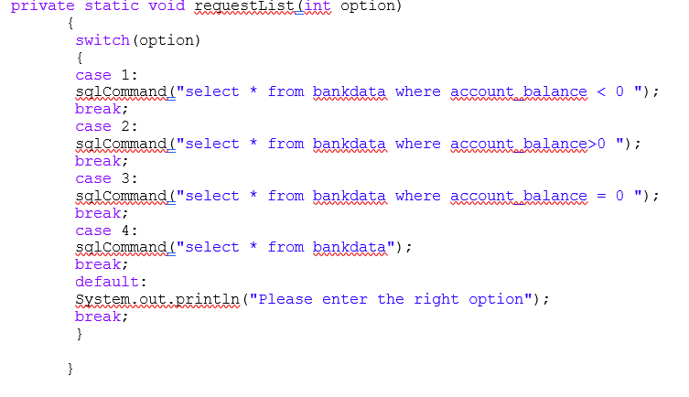
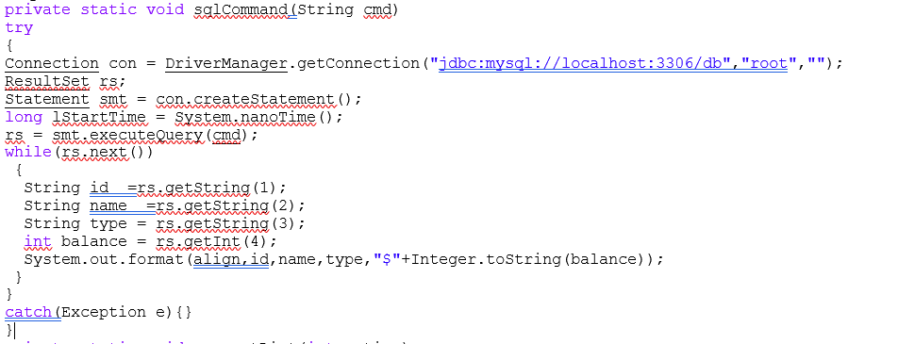
Database

Slide 16
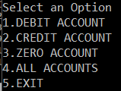
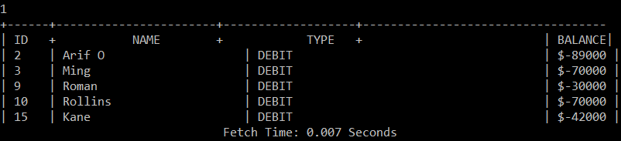
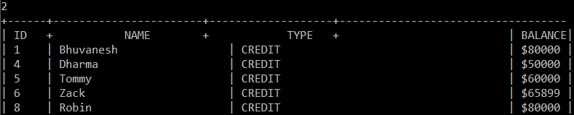
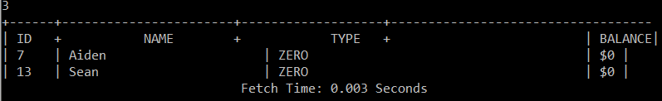
Execution of the Project - Database

Slide 17
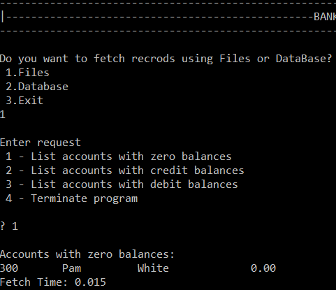
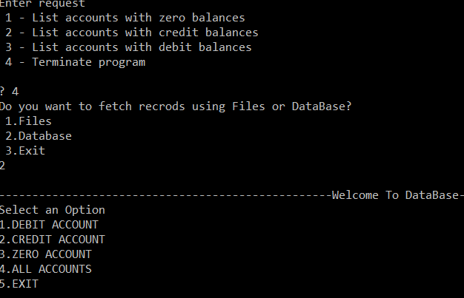
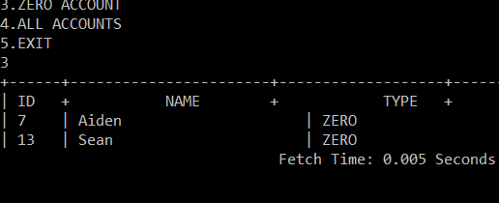
Final Output

Slide 18
Questions?
Thanks everyone!

